Slide 1


New methods for analyzing fungal enzyme secretome:
Digestive secretome composition, an integrated part of speciation
Lene Lange
BioEconomy, Research & Advisory, Denmark
(Research Partner in Danish, Nordic, EU & Internationally funded projects)
Co-authors:
Kristian Barrett, Bo Pilgaard, Jens C Frisvad, Adrian Tsang & Anne S Meyer
Technical University of Denmark and Concordia University of Montreal, Canada
Presented, Asilomar 2022, ”Speciation, Diversity and Evolution”

Slide 2

In Focus: Improved use of the biological resources
Needed: many new types and improved enzymes
Huge opportunities: Enzyme-processing, making ”Value from Waste”
Upgraded use of food waste: Globally, 34% of all food is wasted!
Valorizing food-processing side-streams; now, approx. additional 6-16% wasted!
Improved use of crop residues –unlocking full potential of entire crop plant
Sustainable higher value use of blue biomass, seaweeds & fish cut-offs
Upcycling of residual microbial biomass from biological production (bacteria & fungi)
Making value from organic content of sludge and wastes
Upgraded use of fibers from outsorted textiles, for production of new textiles
Lange, O´Connor et al., 2021: Developing Sustainable & Circular biobased Economy in EU. Front.Bioeng.Biotechnol. 2021

Slide 3
Cascading use is essential:
Unlocking the full potential of the many types of biomass
The Yellow Biomass: Straw, corn-stover & wood chips
The Green Biomass: Green grass & foliage and stems
The Blue Biomass: Fish processing cut-offs & Seaweeds
The Red Biomass: Slaughterhouse waste, blood & cut-offs
The Grey Biomass: Agro-industrial side streams
The Brown Biomass: Sludge & manure; household waste
The Purple approach: Making feed from methane (Negative Emission Tech.)
Lange et al. 2021: Developing a Sustainable and Circular Bio-Based Economy in EU. Front. Bioeng. Biotechnol. 2021

Slide 4
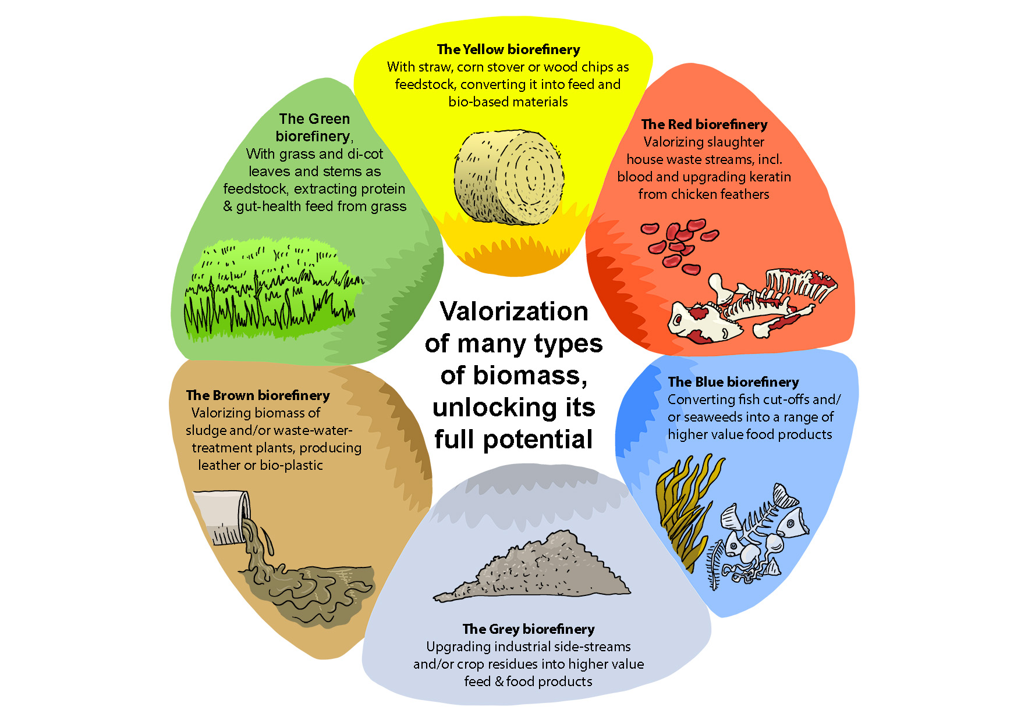
Upgraded use
of the many types of biomass:
Many new enzymes needed!
Lange, L., 2022: Business Models,
including higher value products
for the new circular, resource-efficient
bio-based industry, Frontiers in Sustainability,
Published 3 days ago

Slide 5
Developing Peptide-based Functional Annotation

Slide 6
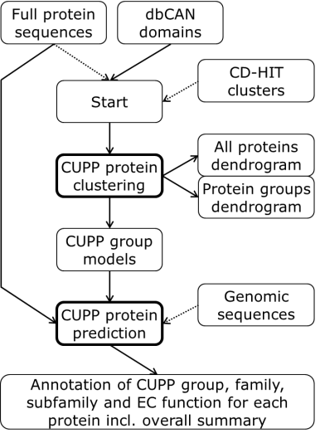
Functional annotation by CUPP,
Conserved, Unique Peptide Patterns
CUPP for CAZymes:
Consists of two stages, Clustering & Function Prediction
Barrett & Lange*, 2019
in Biotech f Biofuel:
CUPP, Peptide-based Functional annotation
Barrett et al., 2020
CUPP as Online functional annotation platform. Nucleic Acid Research, 48, p110-115 TRY IT!

Slide 7
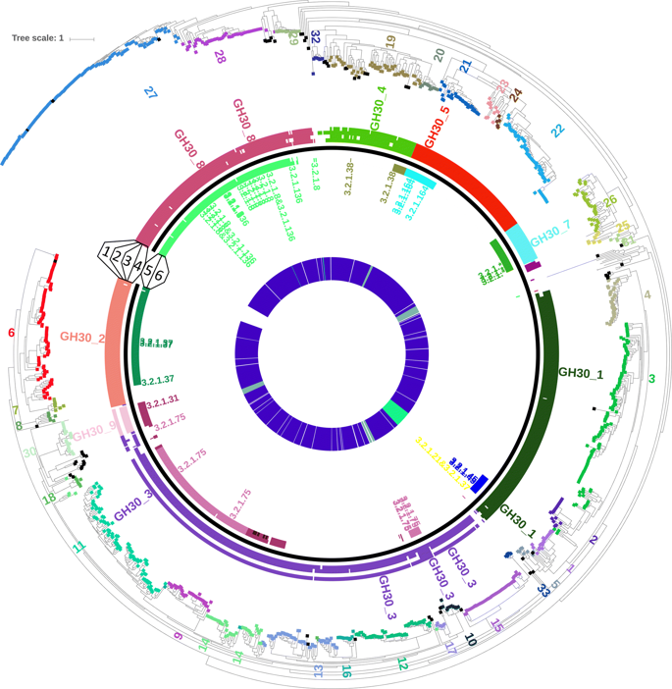
Annotation to CAZyme Family, Subfamily & CUPP group
Validation of CUPP (examplified by CAZyme Family GH30)
In general, each CAZy Family holds several functions
CUPP groups represent a lower level division of CAZyme Families/ Subfamilies
Members of a CUPP group have same EC Function (or share other Function-relevant features)
CUPP Prediction of Function optimizes use of data/information
Prediction of function possible, if just one member of a CUPP group has been characterized

Slide 8
CAZy Family GH30:
Families, Sub-Families
and a surrounding dendrogram of
CUPP-groups
CUPP validation
on GH30

Slide 9
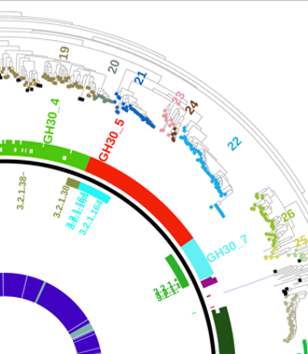
CAZy Family GH30:
Families, Sub-Families
and a dendrogram of
CUPP-groups and
functions

Slide 10
Improvements of peptide-based functional annotation
-from PPR/HotPep to CUPP
CUPP:
All groups formed simultaneously=> Gr#1 no longer disproportionally large
CUPP Group numbers conserved; allowing for comparing results over time
Using Unique peptides for each CAZyme CUPP group –no overlap
Improved Sensitivity and Precision in Prediction of Function
Basic principle covered by same, open-access patent (Busk & Lange)
CUPP available as automated online platform
Busk, PK & Lange, L, 2013: Function-Based Classification of Carbohydrate-Active Enzymes by Recognition of Short, Conserved Peptide Motifs. Appl Environ Microbiol. 79: 3380–3391
Barrett, K & Lange, L, 2019: Peptide-based functional annotation of carbohydrate-active enzymes by conserved unique peptide patterns (CUPP). Biotechnology for biofuels 12 (1), 1-21. CUPP method, description and validation
Barrett, K et al., 2020: Conserved unique peptide patterns (CUPP) online platform: peptide-based functional annotation of carbohydrate active enzymes, Nucleic Acids Research, 48, p110-115. Try it! It is online!

Slide 11
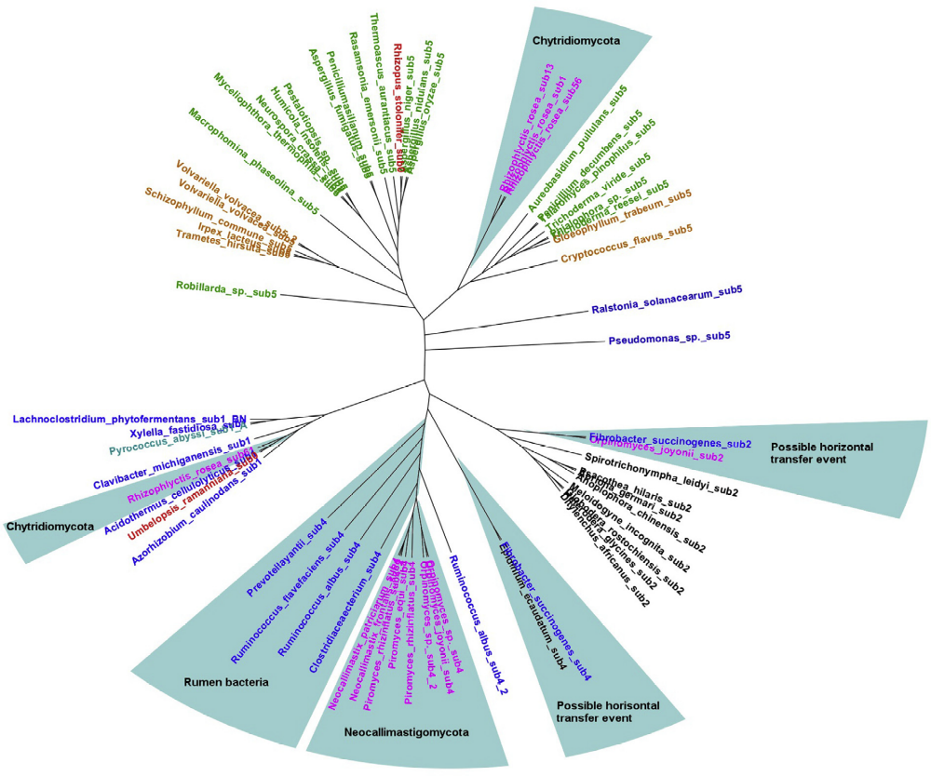
CUPP used for evolutionary perspective
GH5;EC 3.2.1.4 Phylogenetic tree
Ascomycota
Basidiomycota
*Chytridiomycota
Zygomycota
Bacteria
Archaea
Plants
Animals
Lange, Pilgaard, Herbst, Busk, Gleason, Pedersen, 2019:
Origin of fungal biomass degrading enzymes: Evolution,
diversity and function of enzymes of early lineage fungi.
Fungal Biology Reviews, 33: 82-97

Slide 12
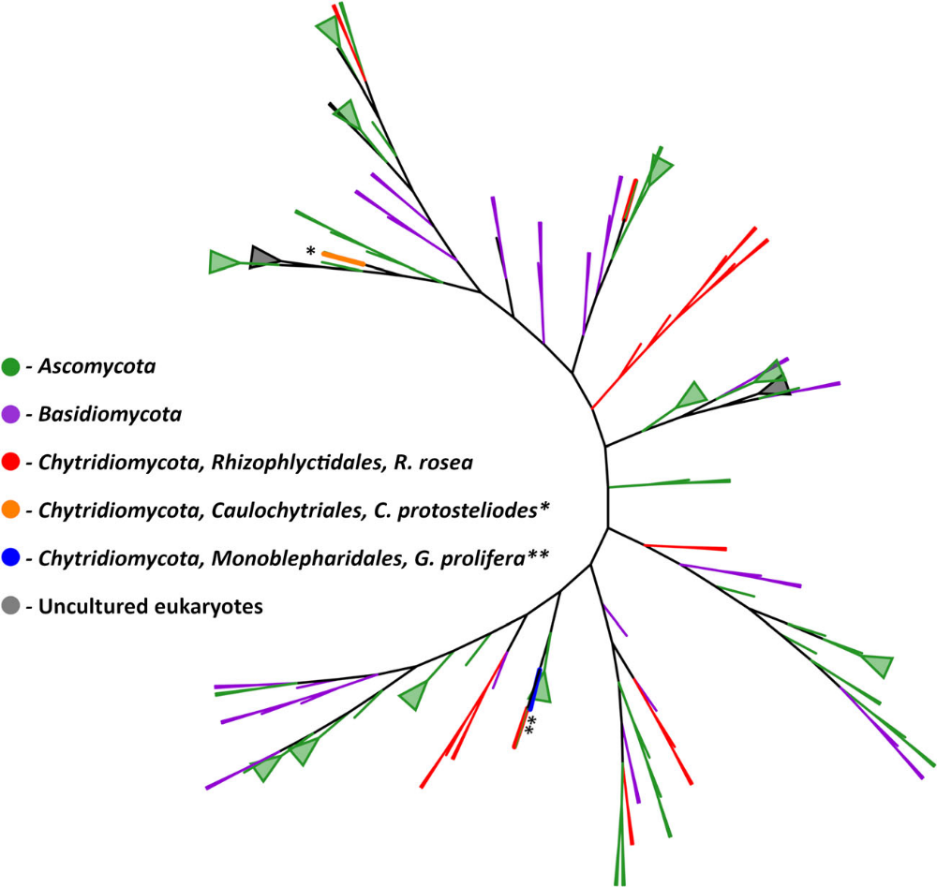
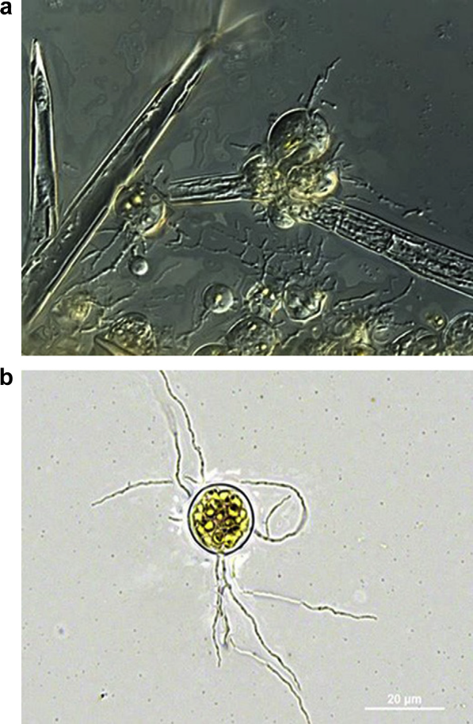
Phylogenetic tree of fungal AA9, placing AA9-diversity of Rhizophlyctis rosea (chytrid) in a Fungal Kingdom evolutionary perspective
Lange, L., Barrett, K., Pilgaard, B., Tsang, A., 2020: Enzymes of early-diverging, zoosporic fungi. Appl Microbiol Biotechnol 103, 6885–6902. https://doi.org/10.1007/s00253-019-09983-w

Slide 13
Elucidating EVOLUTION of composition of fungal enzyme secretome
New functional annotation approach:
Integrating type of protein family and EC-function into one
”Function;Family Observation”
Evolutionary pressure favours:
Having the right digestive functions in optimal types of protein structure:
  Protein structure determines substrate accessibility, stability, pH- and temperature- tolerance and optimum (etc)
Barrett, K, Jensen, K, Meyer, AS, Frisvad, JC and Lange, L, 2020: Fungal secretome profile categorization of CAZymes by function and family corresponds to fungal phylogeny and taxonomy. Sci Rep 10, 5158

Slide 14
Hypothesis:
”F;F”-based dendrogram of a species digestive secretome concures with organismal phylogenetic relationship
Validation model: Genom sequenced species of Aspergillus and Penicillium
Testing hypothesis by Jaccard calculation: Did not confirm hypothesis!
Testing hypothesis by Yule calculation confirmed the hypothesis!
  Yule includes: F;F observations shared & F;F observations shared NOT having
Barrett, Jensen, Meyer, Frisvad*, Lange*, 2020: Fungal secretome profile categorization of CAZymes by function and family corresponds to fungal phylogeny and taxonomy: Example Aspergillus and Penicillium. Scientific Reports (IF4.379), DOI: 10.1038/s41598-020-61907-1

Slide 15
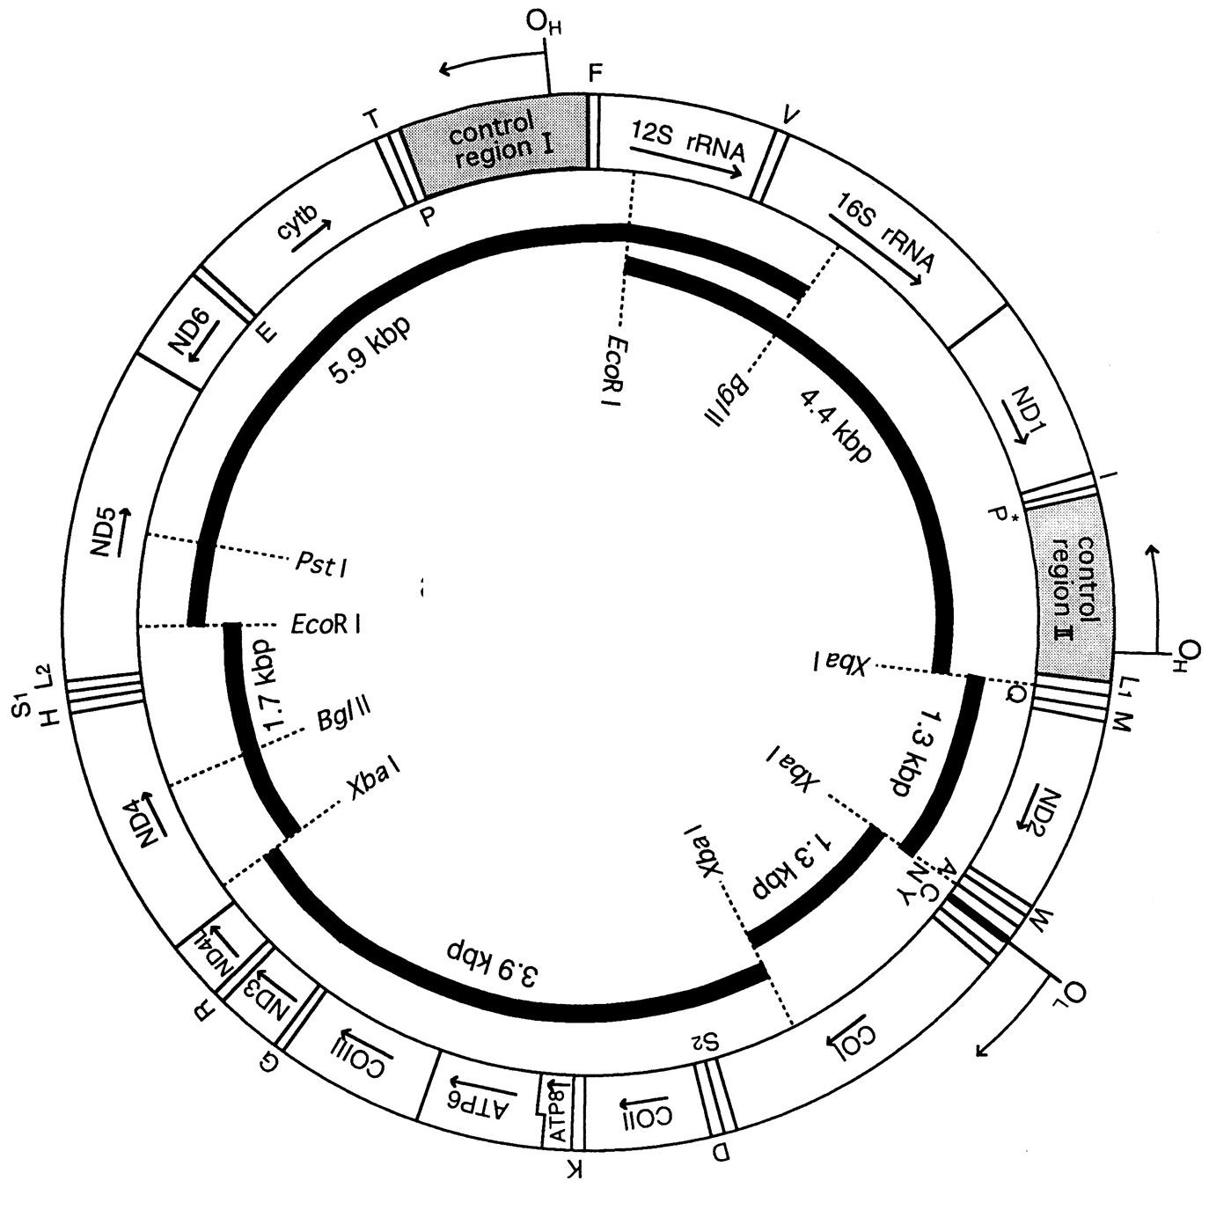
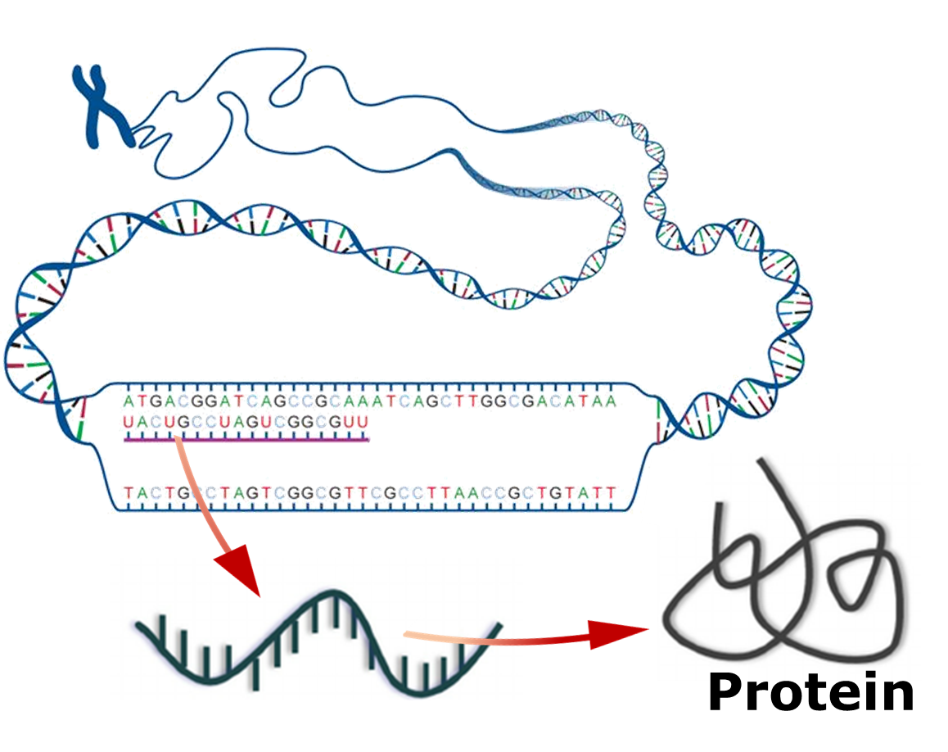
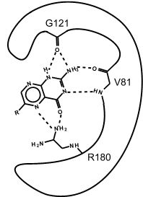
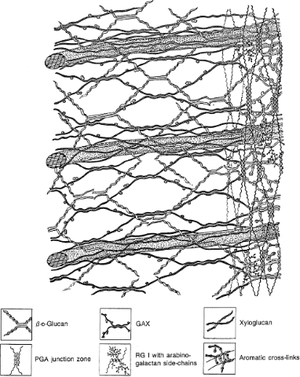





The Enzyme Relatedness method, EPR:
- based on CUPP analysis, establishing ”Function;Family” profile of a species
- opening for cross taxonomy comparisons, identifying CAZyme secretome relatedness
Obtain NCBI’s
fungal genomes
Ab initio predict
genomic proteins
CUPP prediction of
CAZy family
CUPP prediction of
molecular functions
Assignment to
substrate
Cellulose | Xylan | Pectin | Lignin
3.2.1.21;GH1 | 3.1.1.72;CE3 | 3.2.1.23;GH1 | 1.10.3.*;AA1
3.2.1.*;GH1 | 3.1.1.72;CE4 | 3.2.1.23;GH2 | GENERAL;AA2
3.2.1.21;GH3 | 3.1.1.72;CE5 | 3.2.1.31;GH2 | 1.11.1.13;AA2
3.2.1.74;GH3 | GENERAL;CE6 | 3.2.1.55;GH2 | 1.11.1.16;AA2
… | … | … | …
The CUPP predicted molecular function (EC number) is combined with the CUPP annotation to predicted CAZy family. Each of the “Function;Family” observations are assigned to their respective polysaccharide substrates.

Slide 16
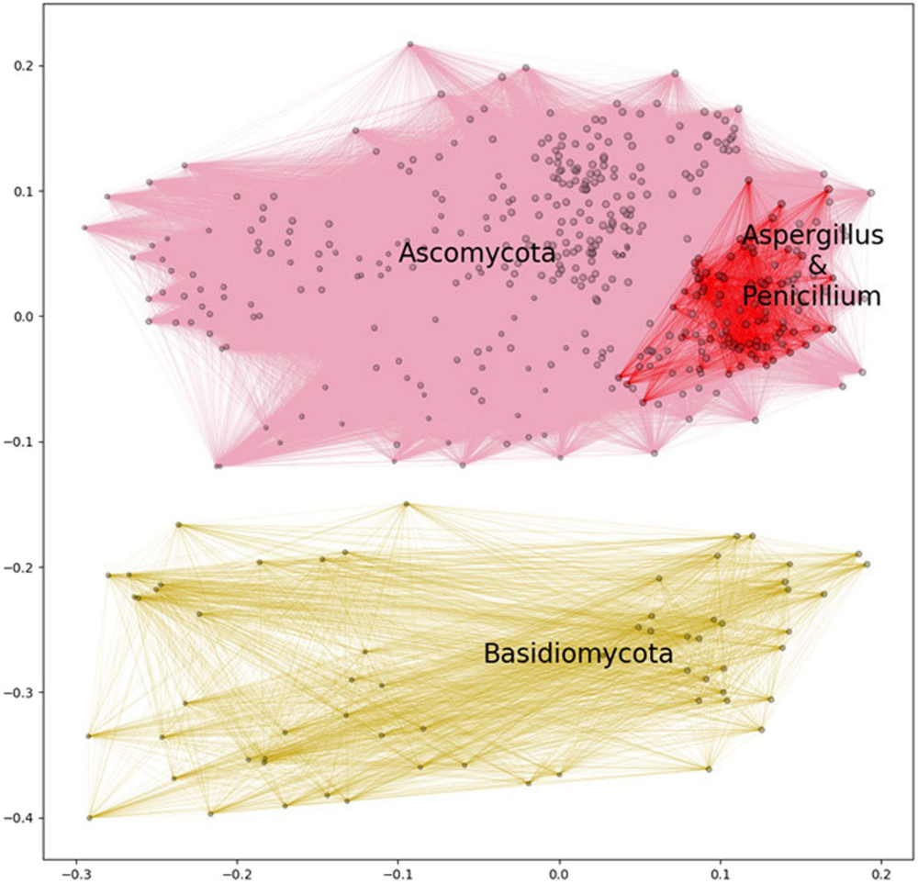
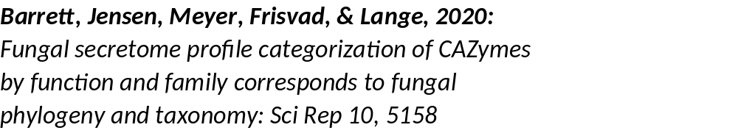
”F;F”-based Enzyme Profile Relatedness EPR- analysis of genome sequenced fungal species=>
Distinct separation of Asco-
from Basidiomycota!
Distinct clustering of
Aspergillus- & Penicillium spp

Slide 17
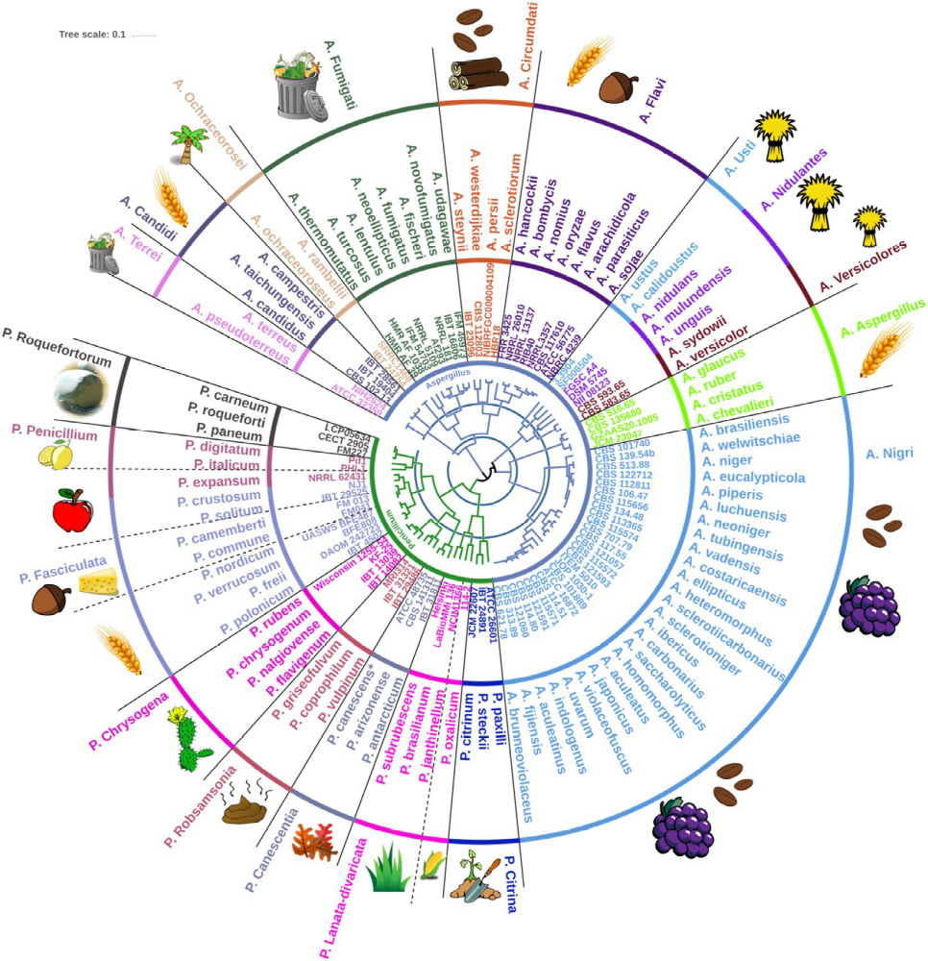
Asp & Pen spp Sections:
”F;F”-based EPR dendrogram (in center)
EPR dendrogram reveals a stunning congruence with phylogenetic grouping of Aspergillus spp and Penicillium spp in sections
Conclusion: Digestive enzyme secretome is an integrated part of speciation. Direct relevance for Fitness, growth/reproduction!

Slide 18
NEW: Enzym ”Hotspot” analysis
Summing up ”F:F” observations for all genome sequenced fungi
Summing up ”F:F” observations per species, allows for ranking of all Fungal Kingdom genome sequenced species (~2.000), according to:
  Richness in CAZyme function-specificity diversity (only unique ”F;F” obs.)
  Total degrading capacity (incl redundant ”F;F” obs.)
Analyzing for fungal CAZyme Hotspots identifies:
  Fungal species ”richest & poorest” in cellulolytic, xylanolytic, pectinolytic & ligninolytic enzyme potential
The fungal enzyme Hotspots are found in very different types of fungi:
  Many surprises: includes e.g. endophytes and stone-fungi
  Strongest degrading capacity: rumen fungi
Lange, L.; Barrett, K.; Meyer, A.S., 2021: New Method for Identifying Fungal Kingdom Enzyme Hotspots from Genome Sequences. J. Fungi 7, 207

Slide 19
The Hot-Spot analysis method
- based on CUPP analysis, summing up ”Function;Family” observations
- opening for cross taxonomy comparisons, identifying fungal CAZyme Hot-Spots
Obtain NCBI’s
fungal genomes
Ab initio predict
genomic proteins
CUPP prediction of
CAZy family
CUPP prediction of
molecular functions
Assignment to
substrate
Cellulose | Xylan | Pectin | Lignin
3.2.1.21;GH1 | 3.1.1.72;CE3 | 3.2.1.23;GH1 | 1.10.3.*;AA1
3.2.1.*;GH1 | 3.1.1.72;CE4 | 3.2.1.23;GH2 | GENERAL;AA2
3.2.1.21;GH3 | 3.1.1.72;CE5 | 3.2.1.31;GH2 | 1.11.1.13;AA2
3.2.1.74;GH3 | GENERAL;CE6 | 3.2.1.55;GH2 | 1.11.1.16;AA2
… | … | … | …
The CUPP predicted molecular function (EC number) is combined with the CUPP annotation to predicted CAZy family. Each of the “Function;Family” observations are assigned to their respective polysaccharide substrates.

Slide 20
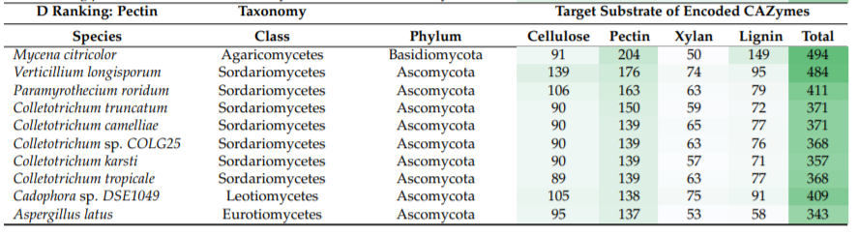
Hot Spot analysis, example
10 top-scoring fungal species, ranked by pectin-degrading capacity
Lange, L, Barrett, K, & Meyer, AS, 2021: New Method for Identifying Fungal Kingdom Enzyme Hotspots from
Genome Sequences. J. Fungi 7, 207

Slide 21
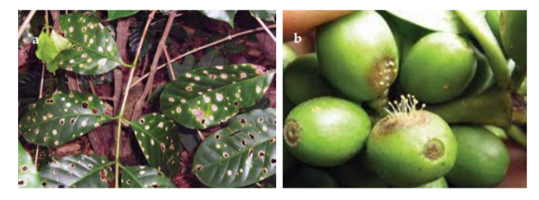
Mycena citricolor, (Agaricales, Basidiomycota)
-a Hot Spot for pectin degrading CAZymes
Mycena citricolor attack on coffee plants, leaves and fruits, illustrates massive degradation
of plant tissue, creating holes in the leaves and sunking in parts of the berries
Photo, courtecy of Andrew Dominick, University of Wisconsin-La Crosse

Slide 22
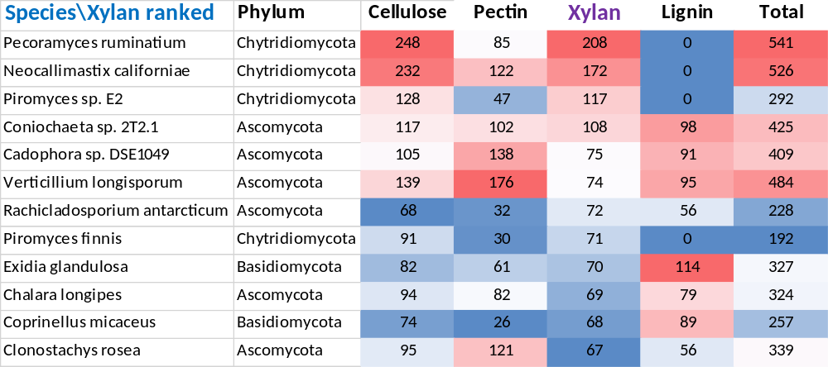
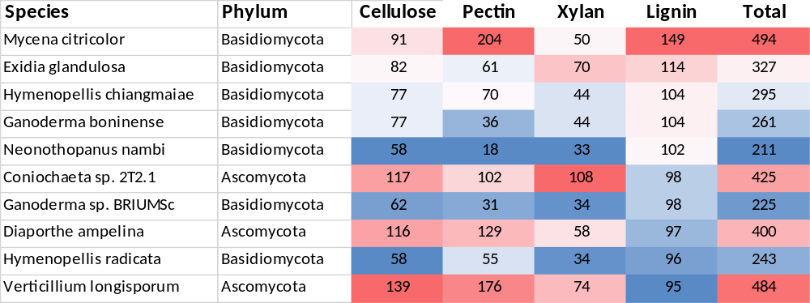
HOT-SPOT ANALYSIS,
Top-scoring species for
Xylan-ranked &
Lignin-ranked
Fungal Kingdom
~2000 genomes
\Lignin ranked

Slide 23
Conclusions
Combining CUPP, EPR & HotSpot =>function-targeted enzyme-profiling & discovery
Digestive enzyme secretome is an integrated part of speciation
  Secretome composition congruent with separation into Sections of Aspergillus & Penicillium
Ranking of enzyme capacity: similarities between cellulose- & xylan-active enzymes
Diversity of enzyme function specificity richest for pectin-active enzymes
Horizontal Gene Transfer appears to be frequent among aquatic, zoosporic fungi
No AA enzymes/LPMOs found in rumen fungi. No lignin-active?
EPR of digestive secretomes can give new input to analysis of complex genera
Applied potential:
  Hotspot opens for new biomass conversion blends for pectin and lignin
  AA3 of unknown functions, prominent in digestive secretome composition

Slide 24

Closing remark:
”Circular & Bio-based food”, (from residues & side-streams etc) represents a huge opportunity for Food security & Climate, Nutrition & Health, Biodiversity & Jobs!
For this we need many new and improved enzymes:
Enzyme discovery for improved enzyme processing is KEY for valorizing the huge amount of biomass going wasted or downgraded
Thanks a lot for your attention
Lene

