Slide 1
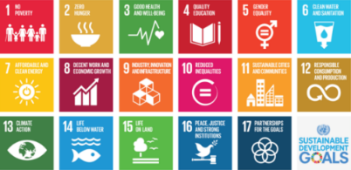


Food systems Microbiomes & Technologies for the Circular Biobased Industry
Lene Lange
LL-BioEconomy, Denmark
SME Research-Partner to Danish, Nordic, European and International projects
Advisory roles in Bioeconomy to EU Commission, Danish Government and NCM Icelandic chairmanship

Slide 2
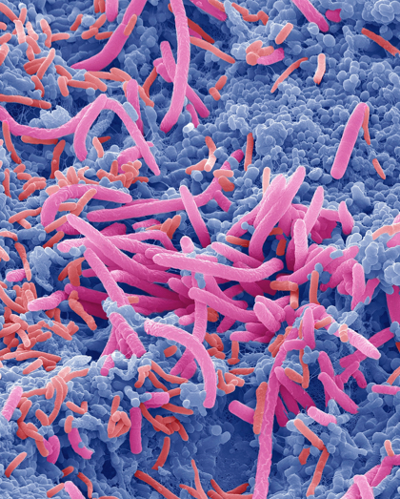
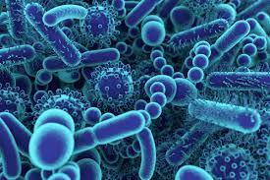
Microbiome research has created new opportunities for Circular Biobased Industry
Health-promoting effect of Biorefinery products can be documented
  For soil microbiomes
  For plant microbiomes, roots and leaves
  For food microbiomes
  For animal gut health
  For human gut health
Microbial cultures for microbiome health can be grown on biomass
Microbiomes can be used for new types of biomass conversion
Monitoring microbiomes can be new pandemic early warning system

Slide 3
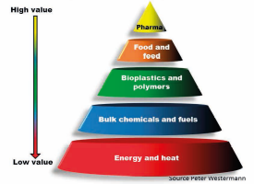
Biorefineries of the Circular Biobased Economy:
Unlocking the full potential of the many types of biomass
Microbiome-health relevant biomasses:
The Yellow Biomass: Straw, corn-stover & wood chips
The Green Biomass: Green grass, leaves and stems
The Blue Biomass: Seaweeds; (Fish processing cut-offs)
The Grey Biomass: Agro-industrial side-streams
The Brown Biomass: Sludge & manure; household waste
Lange et al. 2021: Developing a Sustainable and Circular Bio-Based Economy in EU. Front. Bioeng. Biotechnol. 2021 Lange, L., 2022: Business Models, including higher value products for the new circular, resource-efficient bio-based industry, Frontiers in Sustainability, in press

Slide 4

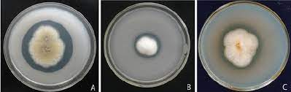
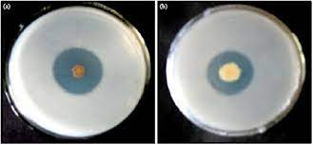
Biorefinery products for improved soil health
Residuals from Biorefinery Biomass conversion can be used
  To improve soil structure
  For cirularity of minerals
  As new types of fertilizers (slow release?)
  And for increasing carbon level
Inoculants for enriching soil microbiomes (e.g. P-solubilizing fungi or bacteria) can be grown on biomass
Phosphorous
solubili-
zation
Agar-test

Slide 5
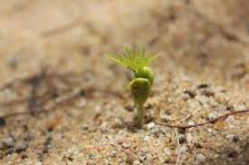

Biorefinery products for improved robustness of plants
Enriched microbiomes of the plant leaves can strengthen the plants
  Biorefinery BioAg products can reduce need for pesticides
  Reduced use of pesticides contribute to stopping loss of biodiversity

Slide 6
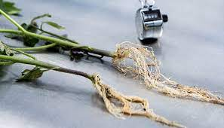
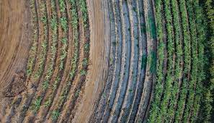
BioAg products can increase tolerance to draught
Enriched microbiomes of the plant roots can strengthen nutrient uptake and increase water-efficiency
New generation of seed-distributed products (endophytes)
  Much needed intervention for climate change challenged agriculture

Slide 7
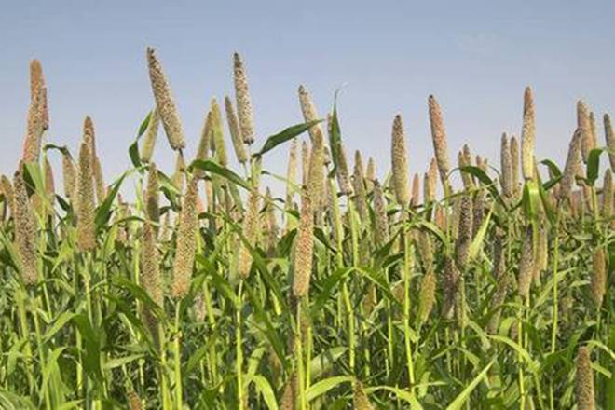
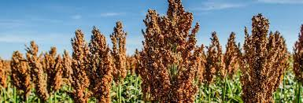
BioAg products for robustness and Upgrade of residues =>
-opening for re-introducing draught-tolerant traditional crops!
Example
Millets and Sorghum, especially of relevance for draught striken regions of Africa and India (pictures, Pearl Millet; Sorghum)
  Upgrading husk and bran to higher value, tasty & micoiome-healthy food!

Slide 8
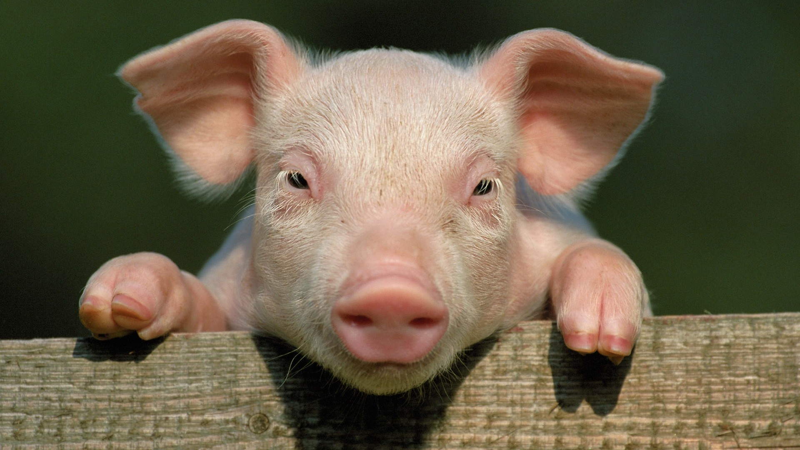
Biorefinery products for improved animal gut-health
Biorefinery products, made from plant polymers can have prebiotic gut-health effect on animal gut microbiome
Bacterial cultures, grown on side-streams can have probiotic gut-health effect
Fermented side-streams can have anti-inflammatory effects
Conclusion & Vision
Combining probiotic, prebiotic plus anti-inflammatory effects can give strong and lasting gut-health improvement
Good for animal welfare and for worker´s health

Slide 9
Acute Need for such animal-gut health products in industrial meat production
May 2022:
30.000 piglets die daily in Danish pig production due to pre-weaning diarrhea. Similar serious issues in other countries

Slide 10
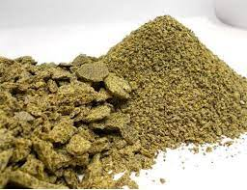
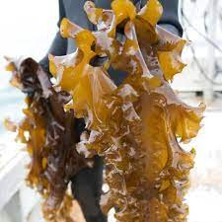
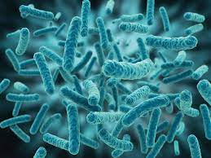

Example of Gut-Microbiome-healthy feed, CBE-produced from upgrading industrial sidestreams
A mixture of rape seed press-pulp with brown macroalage (seaweed) co-fermented by Lactic acid bacteria
  Combining pro-, pre- and anti-inflammatory effects

Slide 11
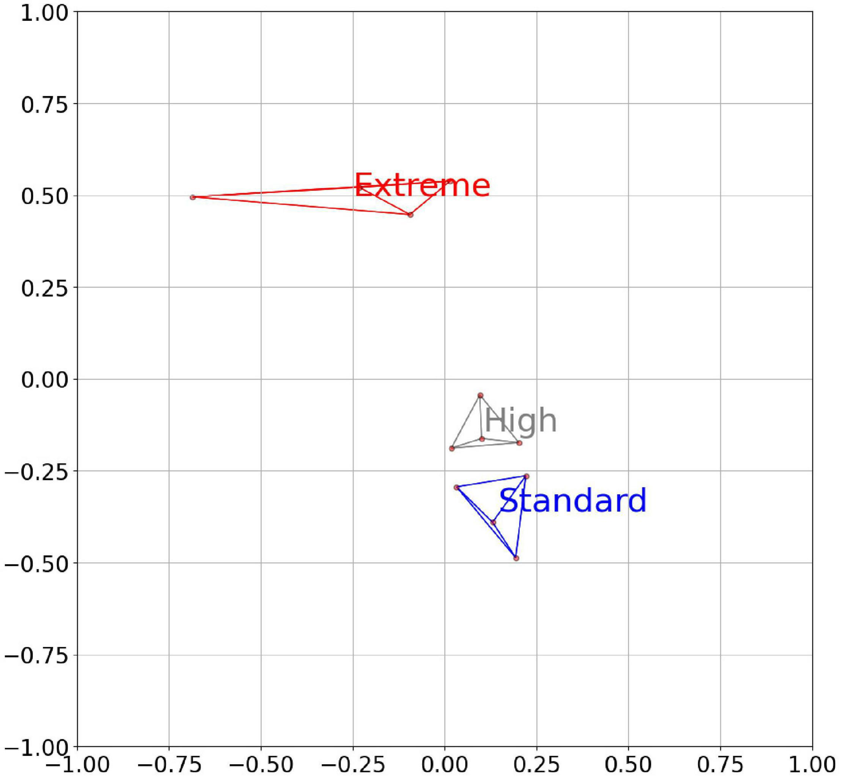
Methane-reducing cattle feed-additives have been found
–produced in future as part of Circular Biobased Solutions!
Feed induced modification of rumen microbiome, in composition & in digestive function:
  Specific types of feeding can give significant methane redution
  Correlation of change of microbiome function to methane reduction
  Reference:
  Barrett K, Lange, L, Børsting, CF., Olijhoek DW., Lund P, Meyer AS, 2022: Changes in the Metagenome-Encoded CAZymes of the Rumen Microbiome are Linked to Feed-Induced Reductions in Methane Emission.
  Frontiers in Microbiology 13
  https://www.frontiersin.org/article/10.3389
  DOI=10.3389/fmicb.2022.855590

Slide 12
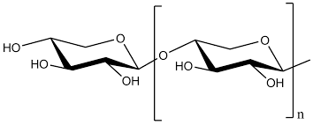
Human* gut-health promoting food ingredients can be produced from industrial side-streams & crop residues
Plant-fiber derived prebiotics:
Xylan sugar oligoes
Pectin oligoes
Etc
Such health-promoting food ingredients can be produced from cell wall fibers of plants, fungi and seaweed =>
–affordable bio-based, health-promoting food supplement can be made from raw materials most often downgraded or wasted
*and animal

Slide 13
New research: People, who have had Covid-19 have higher risk for developing diabetes
Biorefinery products can be important for public health:
Human resilience, gained from healthy gut microbiome has never been more important
  robustness in health takes us better through pandemics and heat waves
Gut-health promoting food supplements can be important for public health
Mirobiome research has paved the way for such improvements
  Creating new local and global business opportunities

Slide 14
The importance of microbiome research for combating risk of antibiotic resistance –a new CBE opportunity for both health and business
Microbiome research suggests, that certain types of bacteria are responsible for the highest propagation of antibiotic resistence genes
If so –could we find out which types of prebiotics for feed could have negative impact on these specific types of bacteria?
This would open for a highly interesting opportunity: Developing new types of selective, prebiotic food supplements with AMR-reducing effect!
Interesting new initiative:
FI: The Fecobiome Initiative
by
Panagiotis Sapountzis*, Serafino Teseo, Saria Otani, Frank Møller Aarestrup, Evelyne Forano, Garett Suen, George Tsiamis, Bradd Haley, Jo Ann Van Kessel, Sharon A. Huws
In press in ”Foodborne pathogens and diseases”

Slide 15
New CBE opportunity?
Microbiome-based fermentations, a new production method for biobased products
In CBE, Bioprocessing is primarily done by single-strain-fermentations (fungi or bacteria) or by enzyme treatments of the biomass
In Anaerobic Digestion (e.g. for production of biogas), the conversion is done by enrichment-consortia of microbes already present in the feedstock, ultimately forming an AD microbiome
New option: A minimal composition microbial consortium, derived from Natural microbiomes. Ex: The gut microbiome of Black Soldier larvae could be used for conversion of mixed household waste

Slide 16
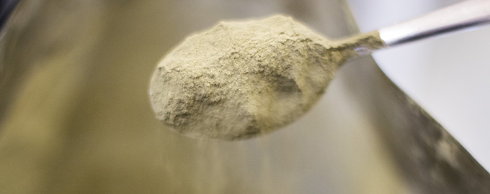
Can household waste in future be used as a substrate for growing fungal single cell protein?
Example*
Use the converted household waste as a growth substrate for producing single cell fungal yeast proteins
Separate the new fungal yeast biomass completely from the waste fraction
Use it as healthy food and feed
  fungal cell wall fragments have microbiome gut-health effects
* Inspired by “Foods of Norway”
A joint effort by Lallemand Animal Nutrition, Borregaard and the Norwegian University of Life Sciences (NMBU), all partners in Foods of Norway at NMBU.

Slide 17

Sustainable, nutritious and healthy food for the sustainable Refugee Camp (LL for CARE Denmark, Camp+ project)
Producing yeast biomass, by growing Baker´s yeast on biomass-sludge, e.g. made from banana-peels or other types of household waste
The resulting protein-rich porridge can be used as food directly, or mixed into bread, soups, mashed (sweet) potatoes (and for feed)
Yeast biomass has been documented through decades to be both highly nutritious and (through polymer-oligoes, derived from the fungal cell wall) having a gut-health promoting effect

Slide 18


Turning waste-water-treatment plants into biorefineries?
Waste water treatment plants build-up a high amount of microbiome/ microbial biomass
Such Anaerobic Digestion microbial biomass have a highly interesting compounds (India, The Netherlands and Australia are pioneering)
  Can be used as basis for Kaumera water-skin/Biobased leather
  Can be used for making Phosphorous-rich fertilizer
  -and for making more products?

Slide 19
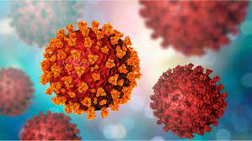
Last but not least:
Develop systems for early warning of new pandemics –for virus, bacteria, and antimicrobial resistance, AMR strains and genes based on sampling the microbiomes of waste water treatment plants

Slide 20
Conclusion
Signifiant value can be generated for food, health & business by using Microbiome Research and Technology in Circular Biobased Economy
Thanks a lot for your kind attention
Lene Lange

